Slide 1
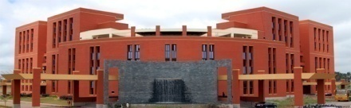
Public Library Dataset
Project team members:
Anant Vaid
R Harish
Tejeshwar U
November 26, 2019
1

Slide 2

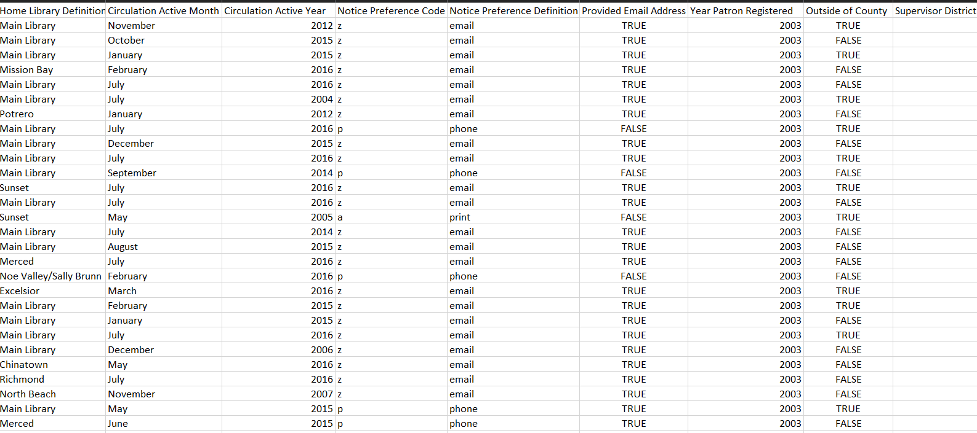
Name of the Dataset
Describe your Dataset
November 26, 2019
2

Slide 3
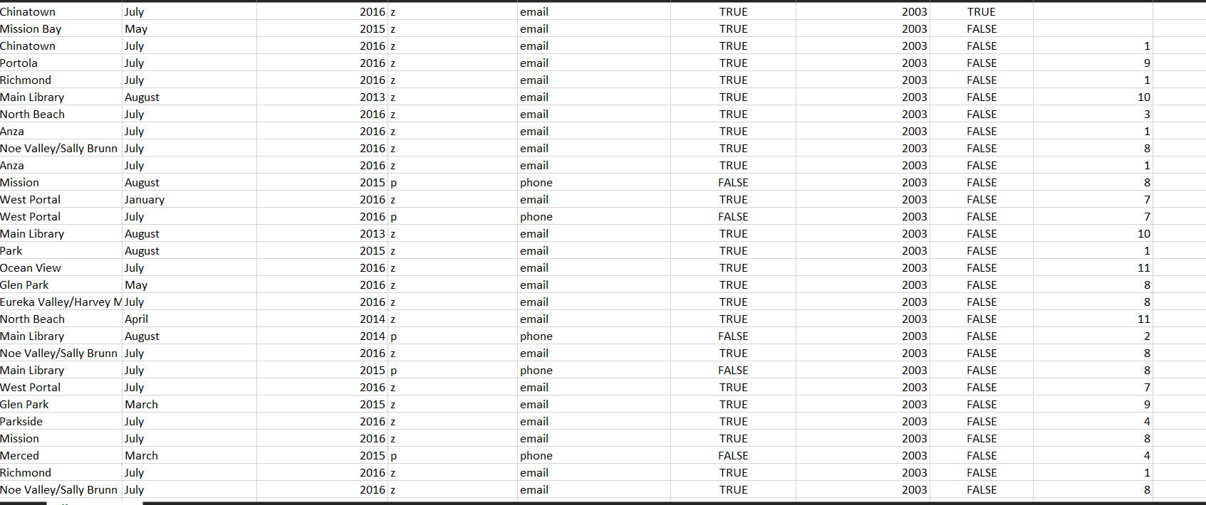
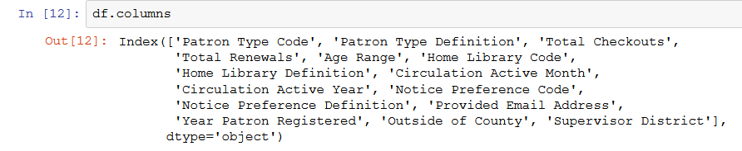
Our dataset consists of 423448 rows and 15 columns with 6 numerical columns and 10 categorical columns.
It is a library dataset and basically shows the number of books checked out
Or renewed and the data related to the number of checkouts.

Slide 4
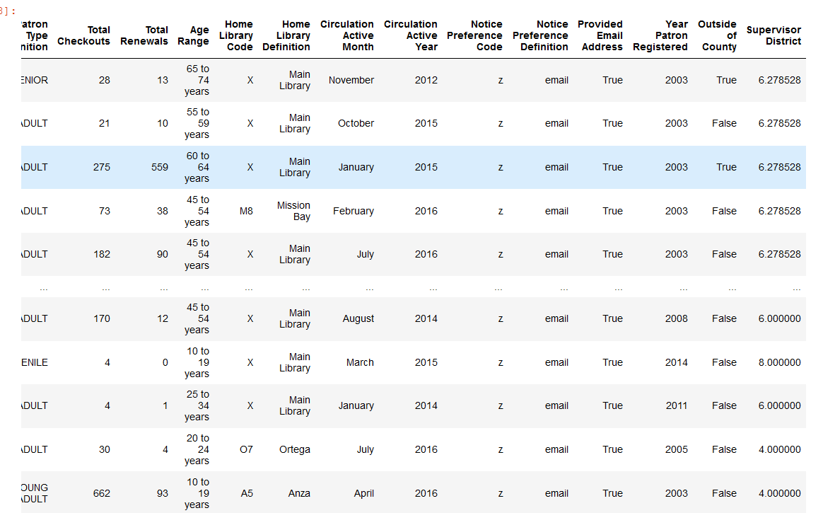
2) DATA CLEANING
As shown above, we fill the nan values of the Supervisor District with the interpolation
of the average of the column above and below. Since there are a large number of data
in the first and since they cannot be filled with the average values of rows above and
below, thus in our case we fill them with the average of the entire column.
November 26, 2019
4

Slide 5
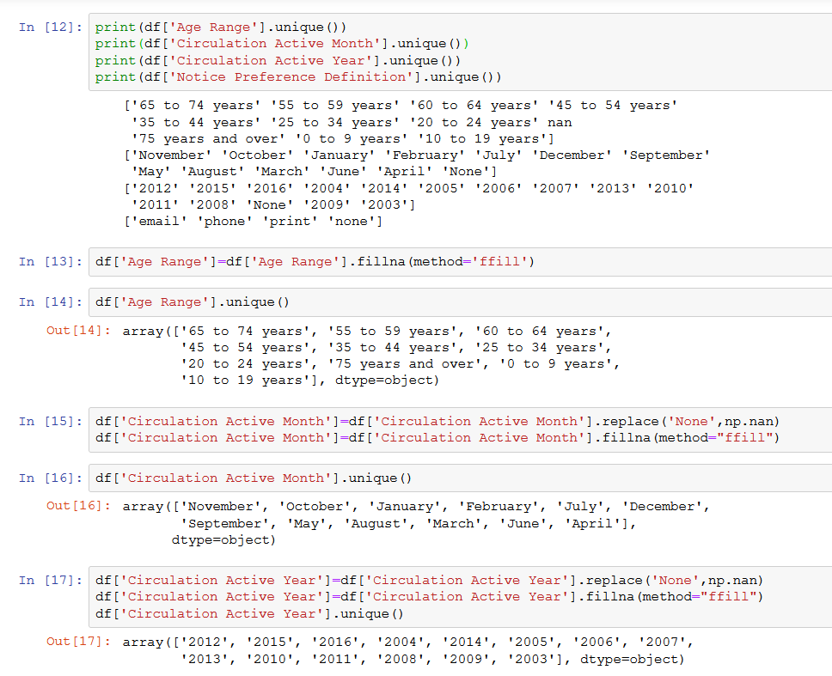
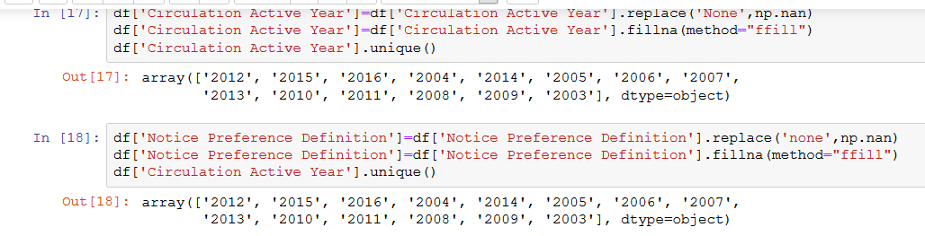
This shows that we removed the ‘None’ values by replacing it with nan and filling
It with the previous row values.

Slide 6
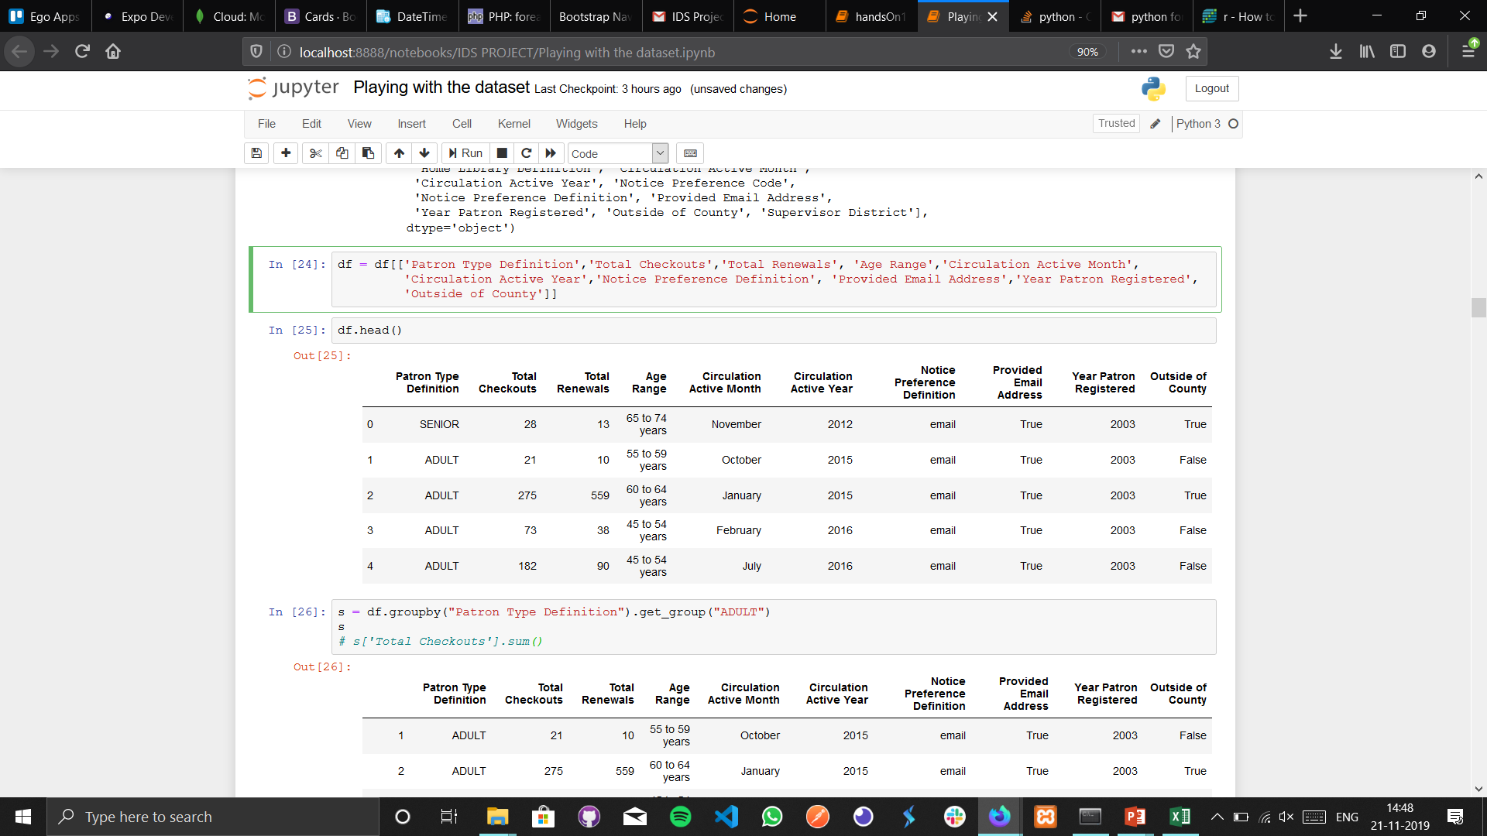
We now drop the columns which are repetitive and which have no sense in our data
Analysis further.
Our dataset is reduced to a Column count of 10 and no nan/missing values.

Slide 7
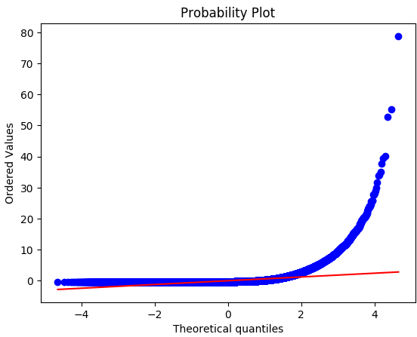
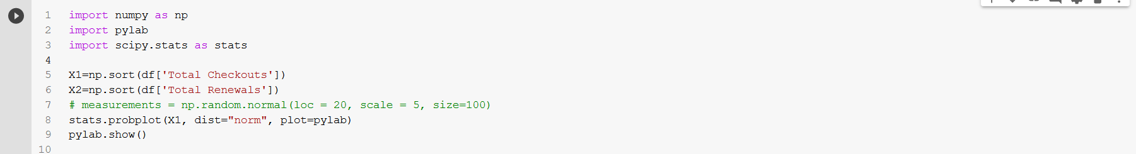
Name of the Dataset
3. Normalization and Standardization:
November 26, 2019
7

Slide 8
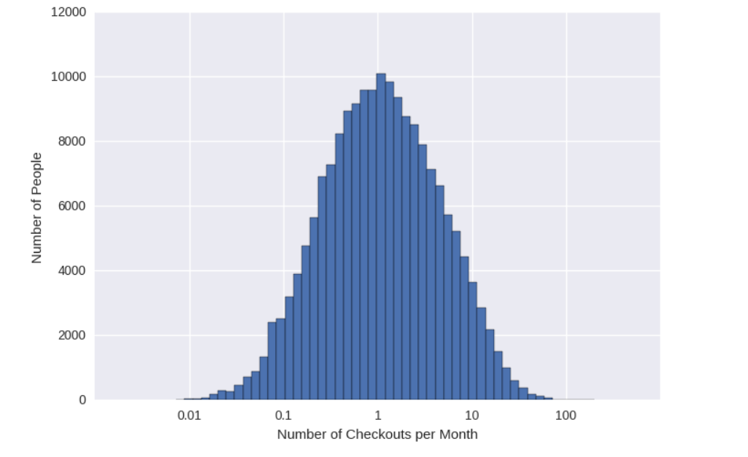
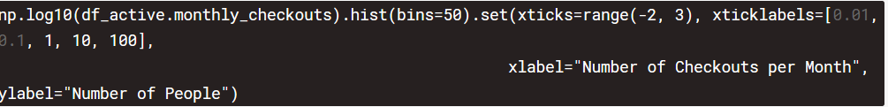
Name of the Dataset
3. Normalization and Standardization:
INSIGHT :- More people checkout b/w 1-10 books
November 26, 2019
8

Slide 9
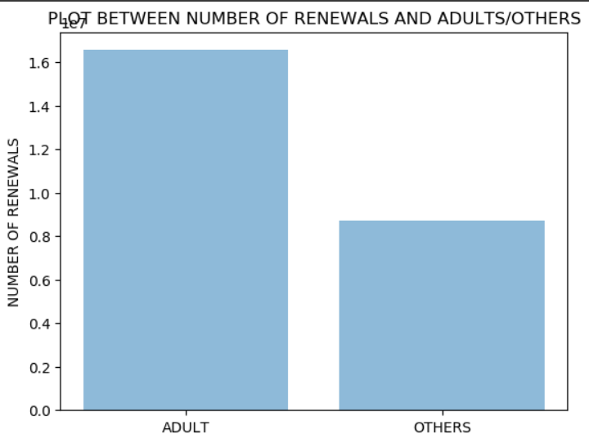
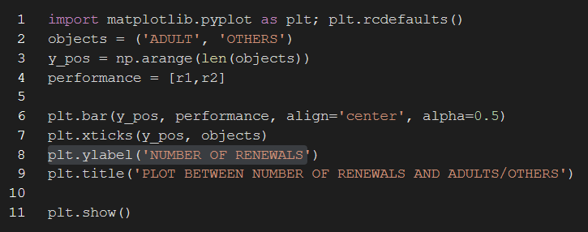
Public Library Dataset
4. Graph visualization:
November 26, 2019
9

Slide 10
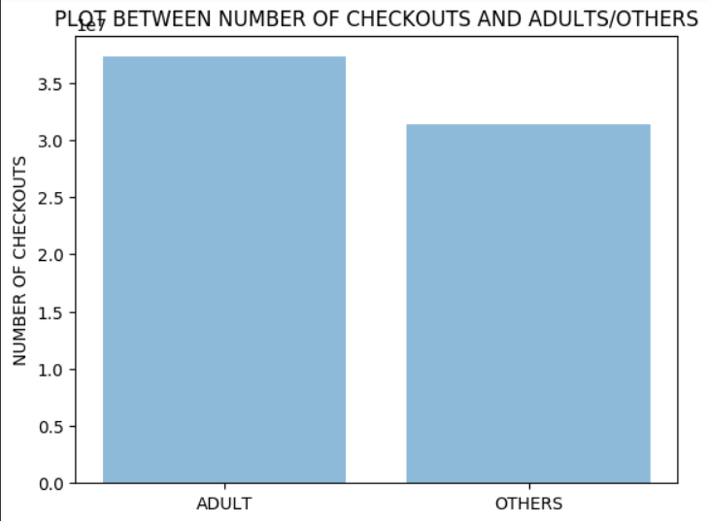
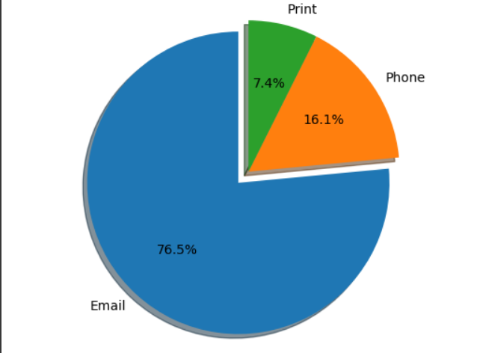
Public Library Dataset
4. Graph visualization:
This insight will be proven in the hypothesis testing as well
Shows E-Mail is the preferred choice people use for library notices
November 26, 2019
10

Slide 11
Public Library Dataset
4. Graph visualization:
Shows E-Mail is the preferred choice people use for library notices
November 26, 2019
11

Slide 12
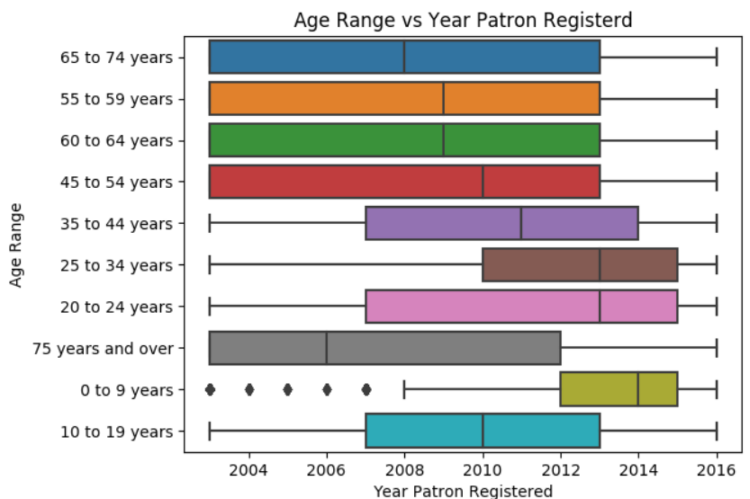
Public Library Dataset
4. Graph visualization:
Shows the younger generation registered Recently..
This may be because of Digitalization. The younger generation look forward to easier access such as Ebooks/Elibrary
San Fransisco library leading the zeniths of digital race
November 26, 2019
12

Slide 13
Public Library Dataset.
5. Hypothesis Testing:
We hypothesize that Adults read more than Others that is the proportion of Adults checkout/renewal is Always greater than or equal to 0.5.
H0 : Proportion of Adult Checkout >=0.5
H1 : Proportion of Adult Checkout <0.5
SHOWS ADULTS READ A LOT MORE THAN OTHERS!!
November 26, 2019
13

Slide 14
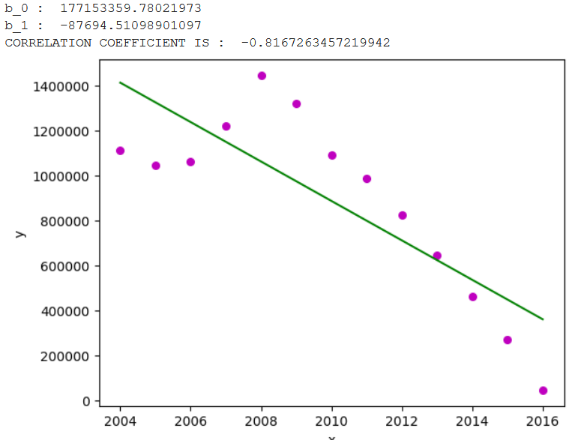
Public Library Dataset
6. Correlation:
We try to get a relativity between the columns -> Total Checkouts and Total Renewals and the Year of Registration and Year of Circulation Active.
We obtain a correlation coefficient of -0.81x.
November 26, 2019
14

Slide 15
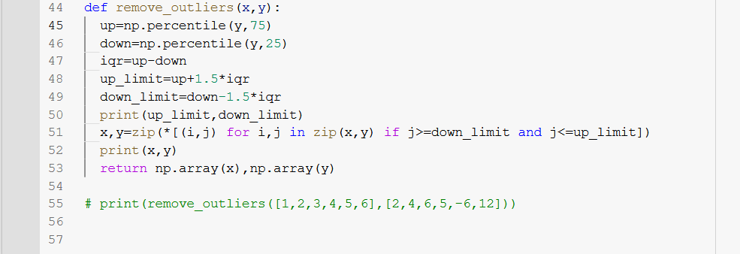
Public Library Dataset
6. Correlation:
First the outliers has to be removed
Why is the regression incorrect here?
November 26, 2019
15

Slide 16
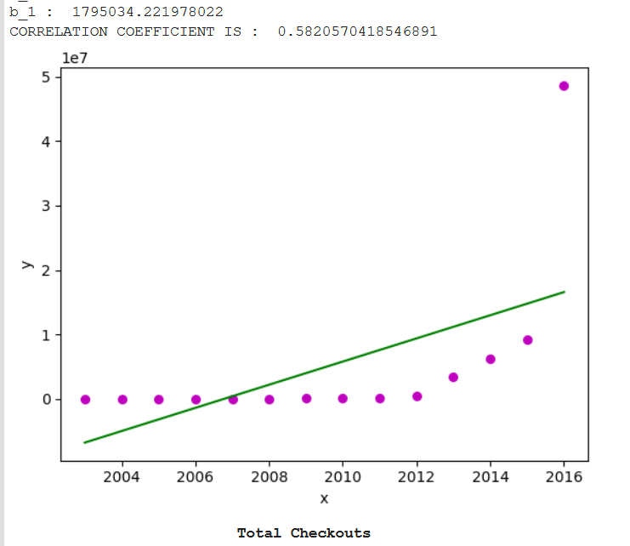
Public Library Dataset
6. Correlation:
We try to get a relativity between the columns -> Total Checkouts and Total Renewals and the Year of Registration and Year of Circulation Active.
We obtain a correlation coefficient of -0.58x.
November 26, 2019
16

Slide 17
Public Library Dataset
6. Correlation:
First the outliers has to be removed
November 26, 2019
17

Slide 18
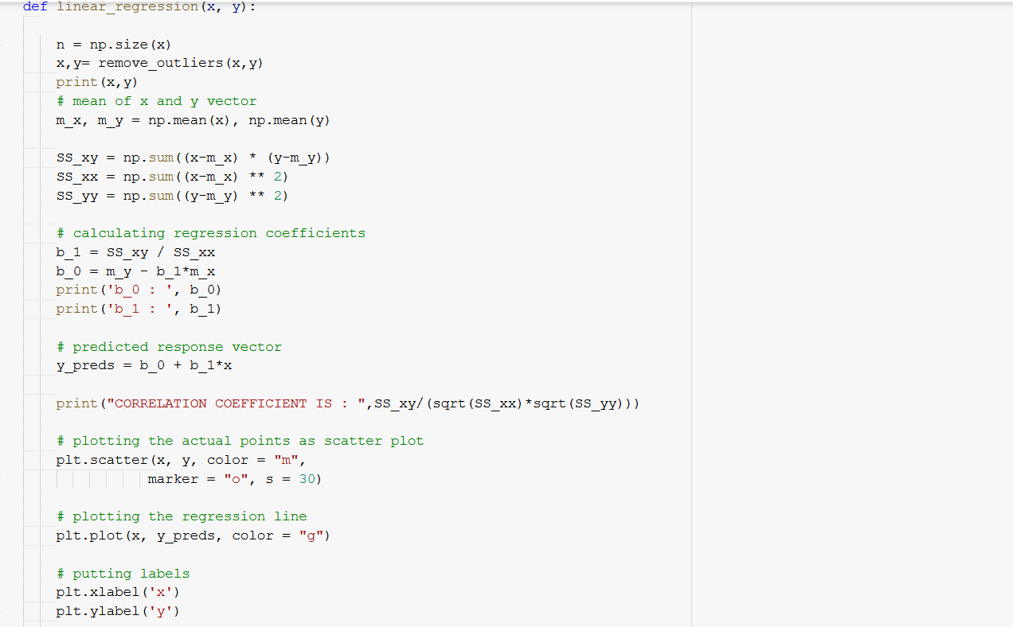
Public Library Dataset
First the outliers has to be removed
6. Correlation Code & Regression
November 26, 2019
18

Slide 19
Name of the Dataset
Thank you
November 26, 2019
19

